Slide 1

SoFi a Finance Company that Can Help You Get Ahead
FinTech Case Study
Domain: Lending

Slide 2

Overview and Origin
Incorporated in August 2011. Its founders: Mike Cagney, James Finnigan, Ian Brady, Dan Macklin. They hoped SoFi could provide affordable options for those to fund their education.

Slide 3
Overview and Origin
The inaugural loan program was a $2 million pilot at Stanford. Forty alumni invested an average of $20,000 to fund 100 students.
In 2012, 2013, and 2014 SoFi raised $ 657 millions from ventures companies, debt and equity, and Series C to expand student loans and to extend into new products like mortgages and personal loans.

Slide 4
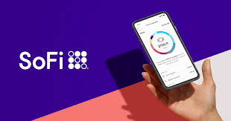
Overview and Origin
SoFi as others best lending companies includes primarily peer-to-peer lending platforms as well as underwriter and lending platforms using machine learning technologies and algorithms to assess creditworthiness.

Slide 5
Business Activities
SoFi’s Costumers are young borrowers with high-end jobs and degrees. SoFi offers student loan refinancing, personal loans and mortgages.
To hold its costumers the company opens up membership with VIP-style member benefits nevertheless the high cost implications.

Slide 6
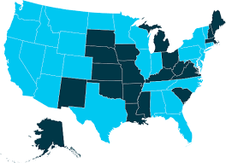
Business Activities
Its big plan is extending its costumers and products. Bank accounts for US citizens and residents. Personal finance operating system with no high fees and clunky digital interface .Wealth management product, digital and physical advice platform, brokerage and crypto.
Also credit cards, and let their costumers buying individual stocks and crypto currencies.

Slide 7
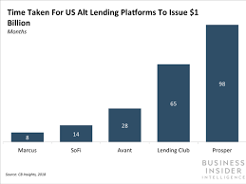
Business Activities
Also competitors have created plans to hold and enter new markets.
Lending Club has extended to home improvement, mortgages, student and personal loans.
Prosper Marketplace, a P2P lender acquired personal finance app.
Kabbage owner of consumer loan brand (Karrot), they has added white label partnership solutions.
SoFi says digital financial services has plenty of room to grow, and it won’t be limited to the lending market.

Slide 8

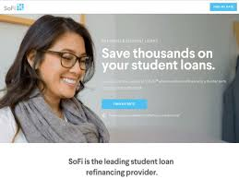
Business Activities
Advantage in relation to its competitors:
No fees or hidden fees, low rates. Career services to its members.
The unfair disadvantage:
SoFi misrepresented the saving on its refinancing student loans (FTC).

Slide 9
Business Activities
Financial and Other Problems:
SoFi is still trying to balance its rapid growth focusing on being a viable and successful business longer term.
SoFi receives a high volume of complaints. BBB is publishing the details of 25% of this business’ complaints online.

Slide 10
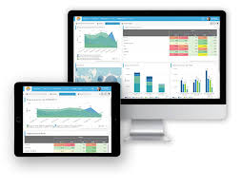
Business Activities
Technologies currently using:
31 Application & Data (Python, MySQL...)
13 Utilities (Jupyter Lab...)
30 DevOps (Git..)
7 Business Tools (Slack..)
Peer-to-peer lending platforms
Underwriter and lending platforms using machine learning technologies
Algorithms to assess creditworthiness.
Kabbage closer competitors is using:
3 Application Data (Apache HTTP ...)
5 Utilities (Google Analytics..)
2 Business Tools (HubSpot..)

Slide 11
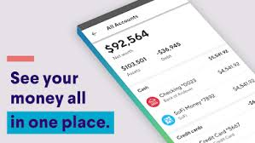
Landscape
Major trends and innovations of the domain:
Mobile Banking: company with the easiest app wins.
Mobile pay: “normal” part of retail
Movil apps: provided by third-party financial service providers
Blockchain: where valuable information needs the utmost security
Automated Wealth Managers: wealth bots.
Complex algorithms: calculate the best investment opportunities
Big Data: needs machine learning tools, process quickly and accurately.

Slide 12
Landscape
This domain is preparing for:
The Future of Account Opening
Driving organizations to move to the cloud
DevOps and innovation thinking on consumer satisfaction.

Slide 13
Landscape
The other major companies in this domain
Affirm
Avant
borro
C2FO
Credit Karma
Fundbox
fundera
Funding Circle
GoRefi
Kabbage
LendingClub
Nova
OnDeck
Orchard
Prosper
Vouch
wonga
ZestFinance

Slide 14
Results
The business impact of this company so far is positive:
Launched in 2011, focused on refinancing student loans. Soon added personal loans and mortgages. The growth fueled by his fundraising prowess and excellent timing. Before long valued in 4 billions and managing a multi-billion dollars loan book.

Slide 15
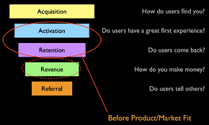
Results
Lending companies are using seven metrics (KPI):
Acquisition Metrics: how many new customers
Activation Metrics: how getting people to use your product
Retention Metrics: how people engaged with your product
Referrals: Willingness to recommend your product to others
Revenues : Daily revenue and number of transactions
Marketing Metrics: How are going your efforts to attract customers
Technical Metrics: Measure trust and security

Slide 16
Results
The visible metrics founded about SoFi are on referrals where 75% of its costumers show their satisfaction. The other 25%, BBB shows on detail the complaints of the costumers.

Slide 17
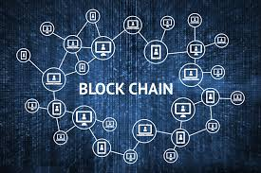
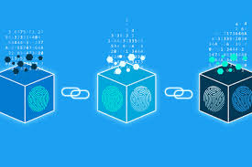
Recommendations
SoFi would have products that use blockchain. The advantage of it is having cash in very short time without waiting one or two days.
Complains from the waiting time for cash would be solved.
I think that SoFi would be one of the first lending companies releasing cash closer to real time.

Slide 18
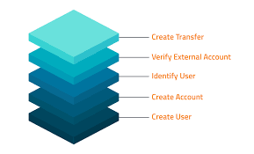
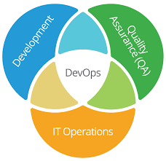
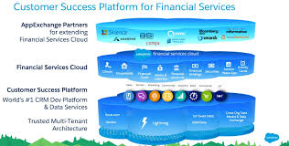
Recommendations
Follow the trend in technology of lending domain such as:
Preparing for the Future of Account Opening
Driving organizations to move to the cloud
DevOps and innovation thinking all the time on consumer satisfaction.

Slide 19
Recomendations
SoFi should be attach to its big plan, working on getting a balance after its successful startup and fast growing.

Slide 20
RESOURCES
Lending domain and SoFi http://empirica-software.com/fintech-companies-lending/
Reviews about SoFi https://www.trustpilot.com/review/sofi.com?utm_medium=trustbox&utm_source=Grid
The future of lending https://www.forbes.com/sites/sarahhansen/2019/02/04/top-lending-fintech-companies/#1f18ccc2775e
Investors https://en.wikipedia.org/wiki/SoFi
Series A B C How it works https://www.investopedia.com/articles/personal-finance/102015/series-b-c-funding-what-it-all-means-and-how-it-works.asp
Complaints at BBB credited business https://www.bbb.org/us/ca/san-francisco/profile/loans/sofi-1116-439036/complaints
Foray into bank accounts https://tearsheet.co/modern-banking-experience/inside-sofis-expensive-customer-acquisition-push/
Technology used at SoFi https://stackshare.io/sofi/sofi
Core metrics for lending companies https://medium.com/swlh/intro-to-kpis-for-fintech-82092070b156
Fintech Analytics: The Top 7 Metrics Every Fintech Company Should Monitor https://www.benzinga.com/fintech/19/06/13911172/fintech-analytics-the-top-7-metrics-every-fintech-company-should-monitor
AARRR metrics http://startitup.co/guides/374/aarrr-startup-metrics
Blockchain Technology https://www.blockchain-council.org/blockchain/top-10-companies-that-have-already-adopted-blockchain/

